Slide 1
08-28 Computational Physics

Slide 2
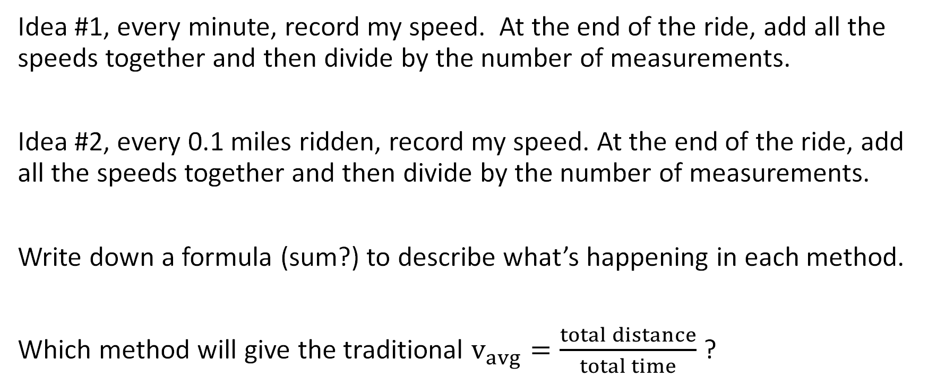
What’s my average speed on a bike?
Idea #1, every minute, record my speed. At the end of the ride, add all the speeds together and then divide by the number of measurements.
Idea #2, every 0.1 miles ridden, record my speed. At the end of the ride, add all the speeds together and then divide by the number of measurements.
Write down a formula (sum?) to describe what’s happening in each method.
Which method will give the traditional $v_{avg}=\frac{total distance}{total time}$ ?

Slide 3
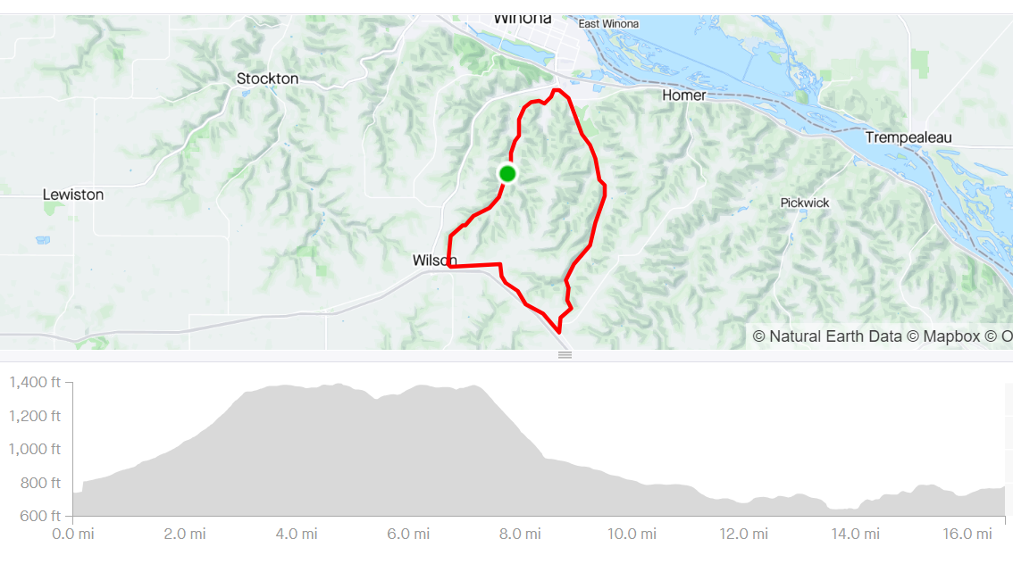

Slide 4
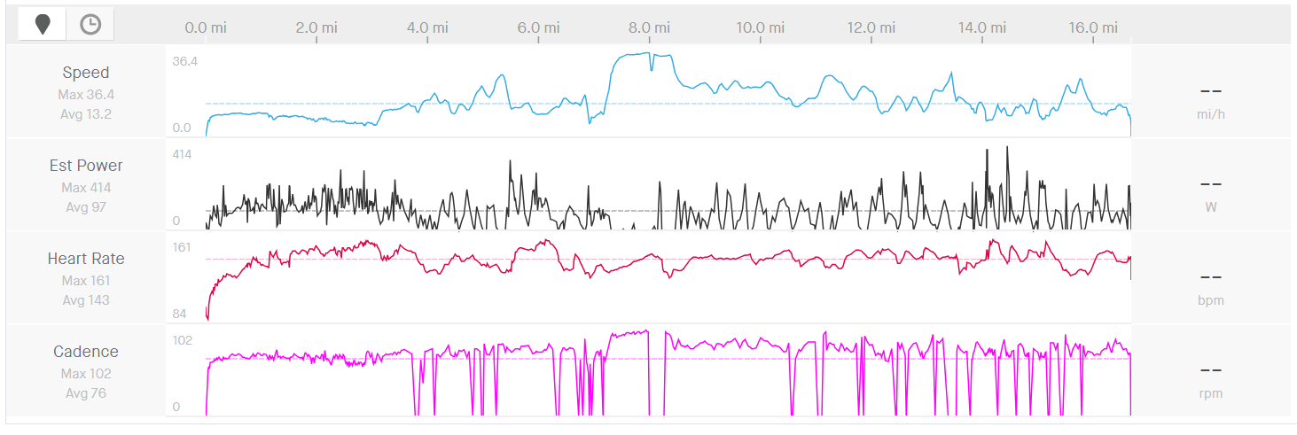

Slide 5

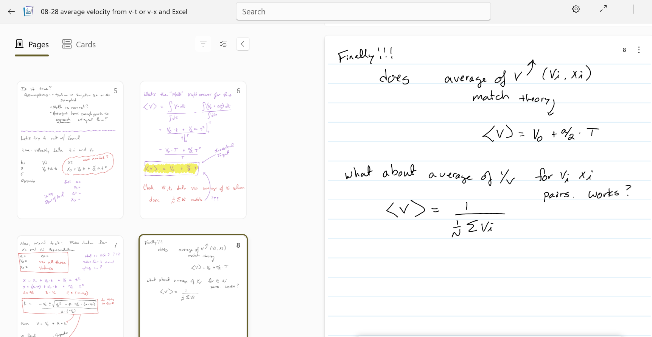
Notes are in Microsoft Journal. Not a terrible program
https://www.microsoft.com/en-us/garage/profiles/journal/

Slide 6
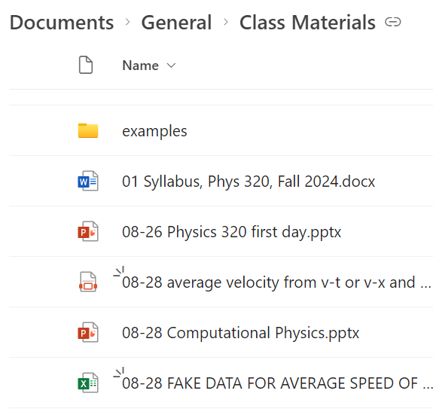
Notes here

Slide 7
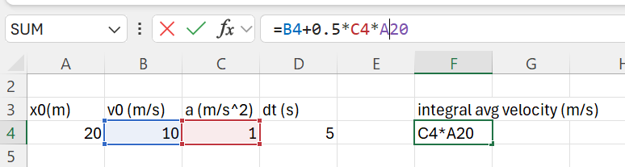
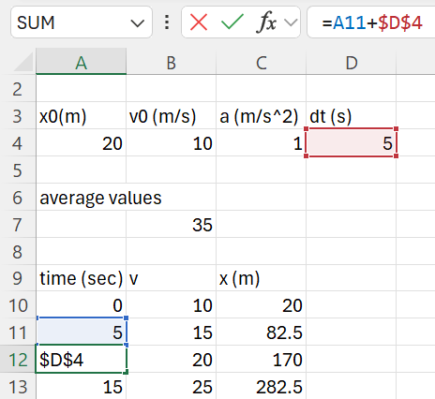
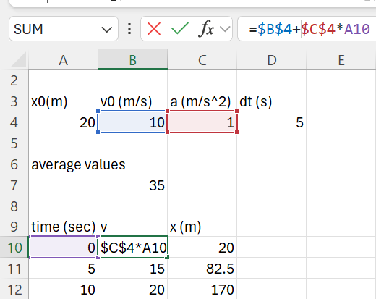
Most of the world runs on Excel!?!? Velocity-time data

Slide 8
Velocity-Position data

Slide 9
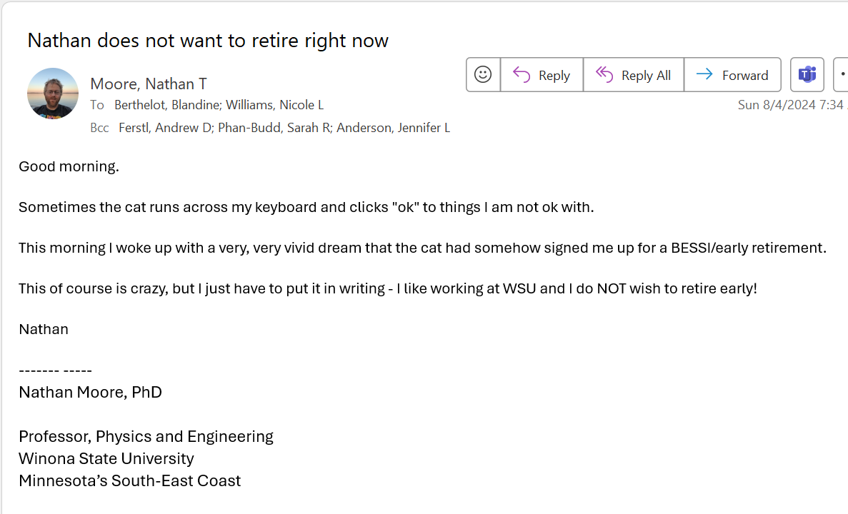
Working in Excel, what could go wrong?

Slide 10
Working in Excel, what could go wrong?
Random “cat typing” and cell dragging errors
Undo is there, but how many undos is enough?
If you change your mind, what record is there?
If you change your mind about changing your mind…
When inheriting a sheet from your boss/co-worker/ex-coworker and wonder “WTF does this cell do????”

Slide 11
Excel is great, but…
Version control (keep track of edits, changing your mind, etc)
Comments to explain your thinking!
The math you do MUST be explicit, not hidden inside a cell
Programming languages (any of them!) can do this better than Excel.

Slide 13
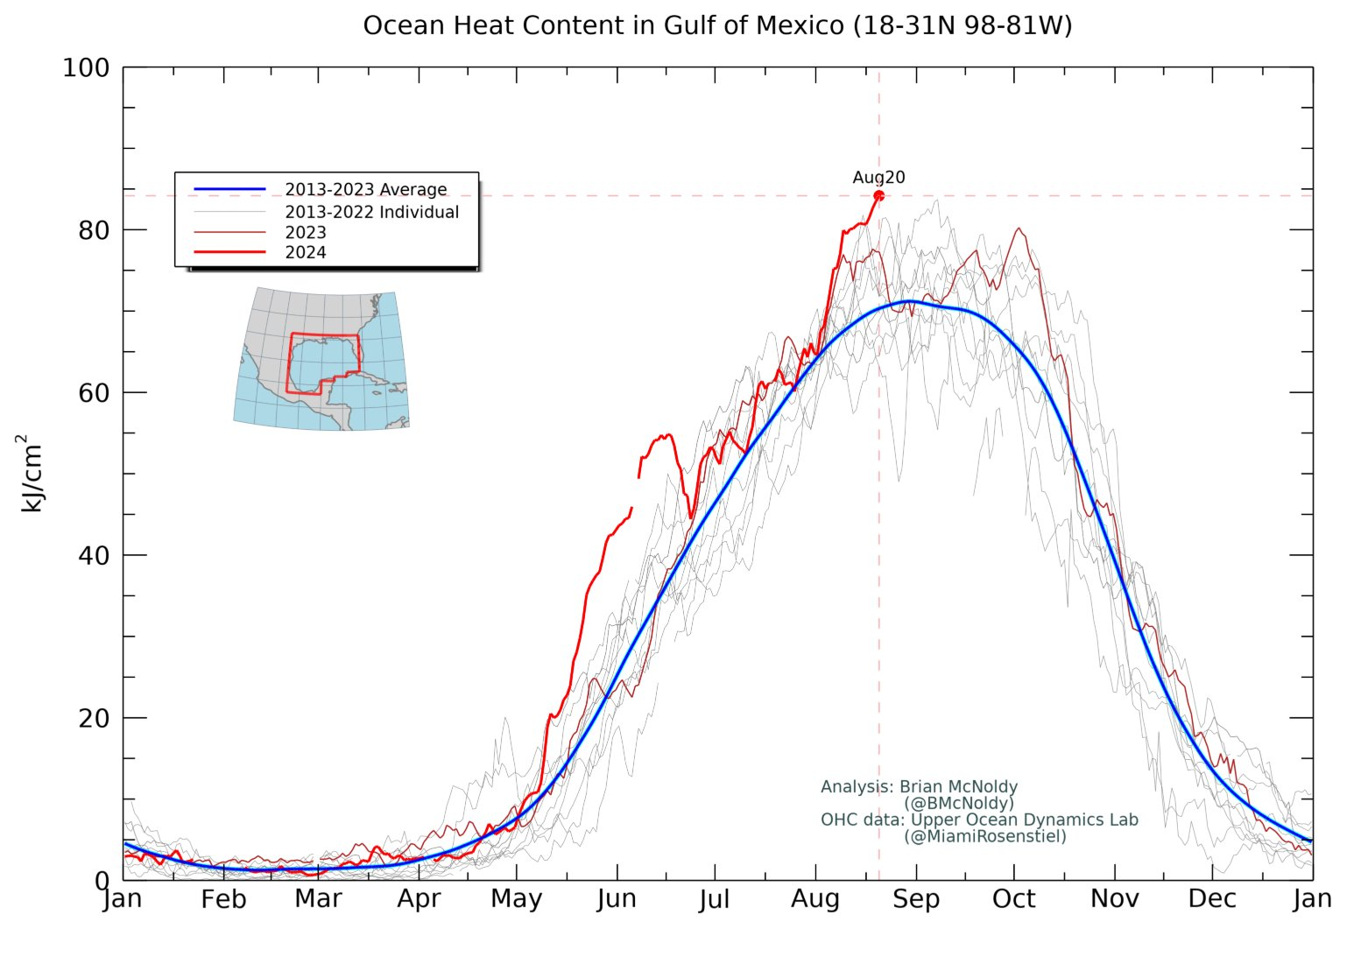
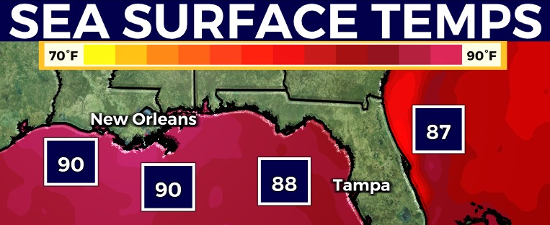
What will the weather be like tomorrow?
Notes:
Taylor series

Slide 14
What will the weather be like: 1. tomorrow? 2. in a week? 3. in a year?
Notes:
Taylor series

Slide 15
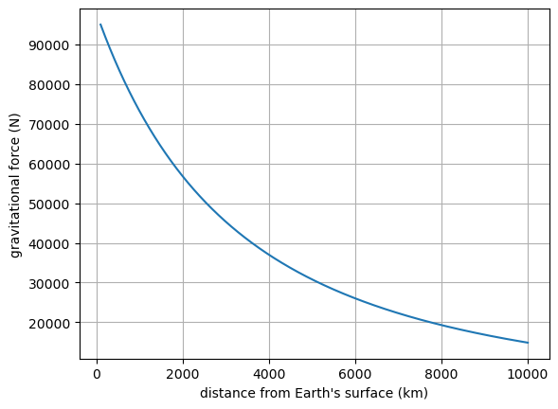
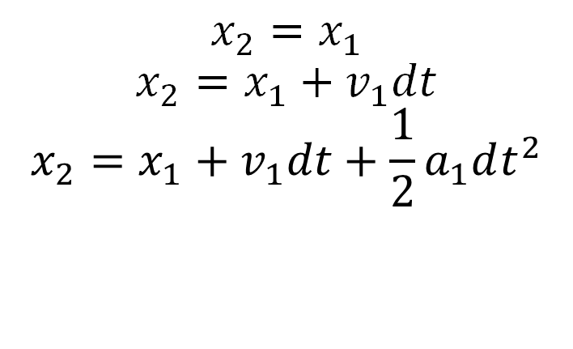
Elon Musk is going to Mars (good riddance?). Kinematics, area, series expansions
$$x_{2}=x_{1}$$
$$x_{2}=x_{1}+v_{1}dt$$
$$x_{2}=x_{1}+v_{1}dt+\frac{1}{2}a_{1}dt^{2}$$

Slide 16
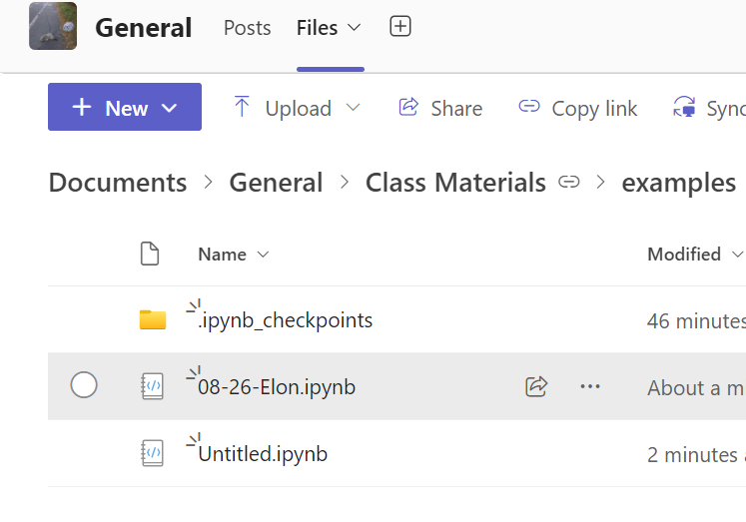
Here’s an example Python code

Slide 17

It takes about 24hours to coast to the Moon (Ranger 7 mission)
We could pay people to work out the trajectory in 1 second fidelity
$$x_{2}=x_{1}$$
$$x_{2}=x_{1}+v_{1}⋅dt$$
$$x_{2}=x_{1}+v_{1}⋅dt+\frac{1}{2}⋅a_{1}⋅dt^{2}$$
$$F_{g}=G\frac{M_{1}M_{2}}{r^{2}}$$

Slide 18
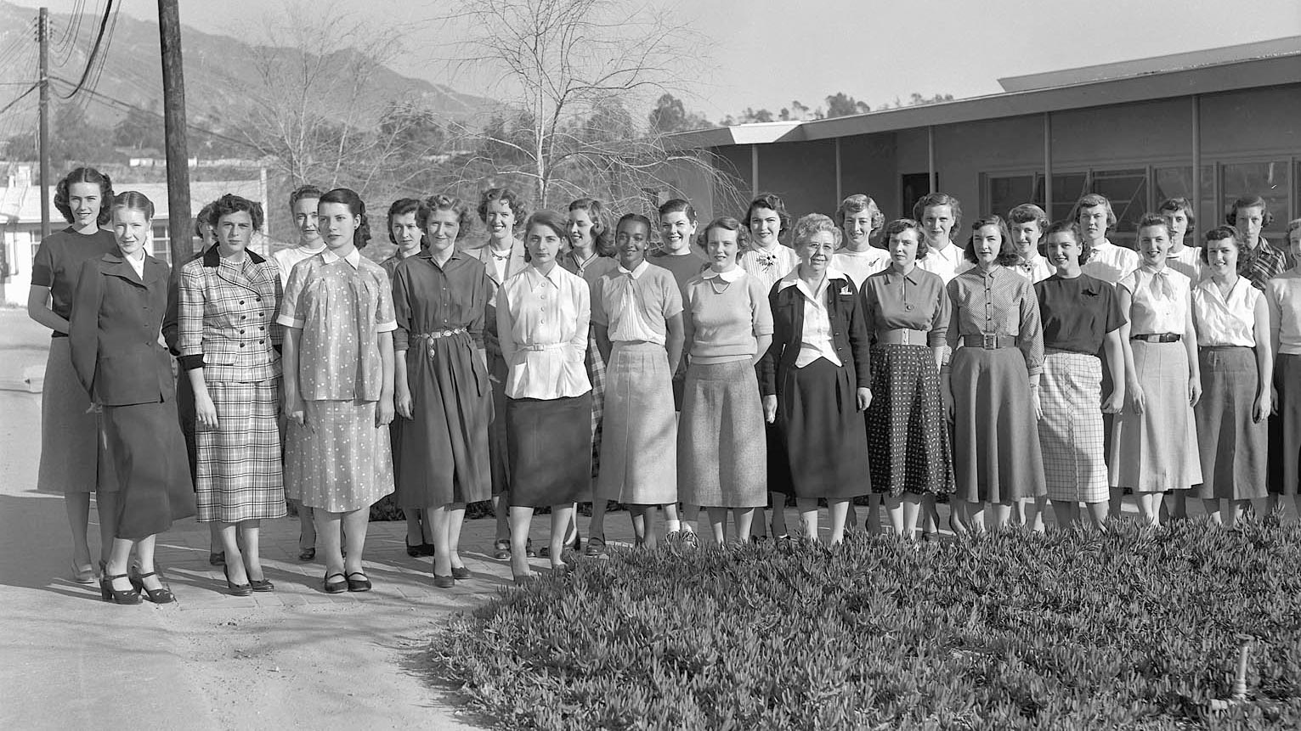
During the 1940s and 1950s, JPL used the word "computer" to refer to a person rather than a machine. The all-female computer team, many of the members recruited right out of high school, were responsible for doing all the math by hand required to plot satellite trajectories and more.
Notes:
https://en.wikipedia.org/wiki/Computer_%28occupation%29

Slide 19
Computational Physics:
Normally involves discrete numbers, not functions
Quality depends on the care of programmers (eg units, is dt small enough)
Isn’t “traditional” computer science (NTM MSFT recruiter string-copy story) but ironically, physics+math “invented” CS
Depends on documentation and clarity
Uses many languages (NTM has done “real” work in Excel, Python, Perl, C, C++, Fortran, Verilog, G-Labview, Matlab etc)

Slide 20
This isn’t a CS class – our focus is on Physics

